Slide 1


The basics of file systems

Slide 2
The basics of file systems
Consensus in a distributed system
Today we are going to see how to implement a reliable distributed FSM.

Slide 3
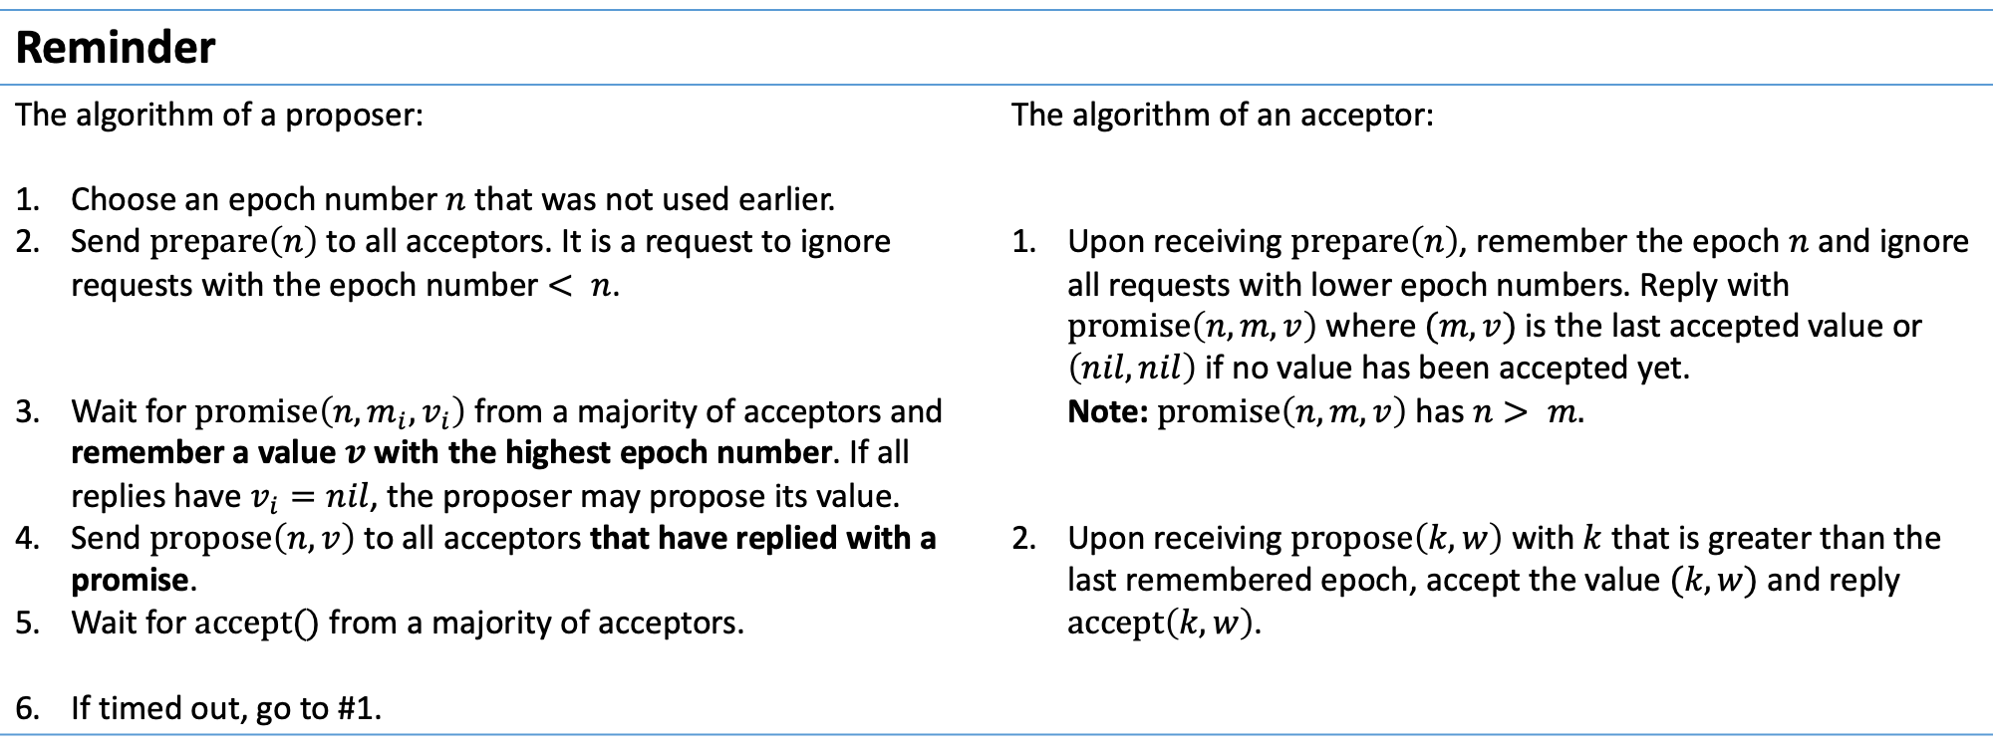
The basics of file systems
Reminder
The algorithm of a proposer: Choose an epoch number $n$ that was not used earlier. Send $\operatorname{prepare}\left(n\right)$ to all acceptors. It is a request to ignore requests with the epoch number $< n$. Wait for $\operatorname{promise}\left(n, m_{i}, v_{i}\right)$ from a majority of acceptors and remember a value $v$ with the highest epoch number. If all replies have $v_{i}=nil$, the proposer may propose its value. Send $\operatorname{propose}\left(n, v\right)$ to all acceptors that have replied with a promise. Wait for $accept()$ from a majority of acceptors. If timed out, go to #1. | The algorithm of an acceptor: Upon receiving $\operatorname{prepare}\left(n\right)$, remember the epoch $n$ and ignore all requests with lower epoch numbers. Reply with $\operatorname{promise}\left(n, m, v\right)$ where $(m, v)$ is the last accepted value or $\left(nil, nil\right)$ if no value has been accepted yet. Note: $\operatorname{promise}\left(n, m, v\right)$ has $n> m.$ Upon receiving $\operatorname{propose}\left(k, w\right)$ with $k$ that is greater than the last remembered epoch, accept the value $(k, w)$ and reply $\operatorname{accept}\left(k, w\right)$.

Slide 4
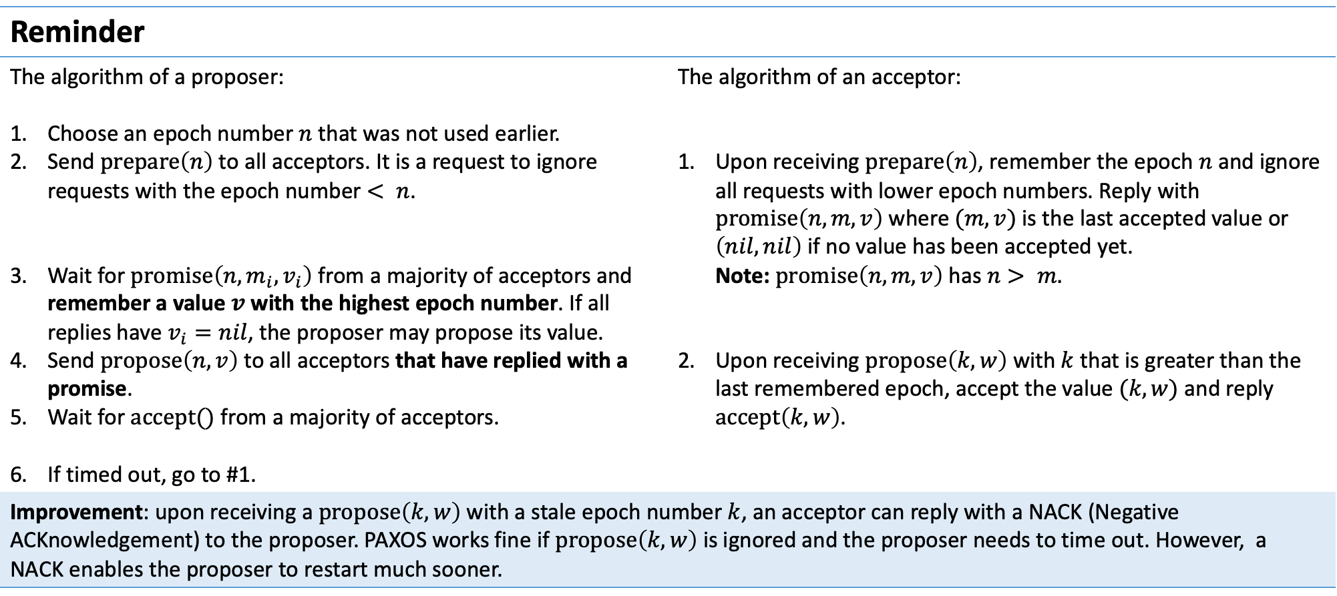
The basics of file systems
Reminder
The algorithm of a proposer: Choose an epoch number $n$ that was not used earlier. Send $\operatorname{prepare}\left(n\right)$ to all acceptors. It is a request to ignore requests with the epoch number $< n$. Wait for $\operatorname{promise}\left(n, m_{i}, v_{i}\right)$ from a majority of acceptors and remember a value $v$ with the highest epoch number. If all replies have $v_{i}=nil$, the proposer may propose its value. Send $\operatorname{propose}\left(n, v\right)$ to all acceptors that have replied with a promise. Wait for $accept()$ from a majority of acceptors. If timed out, go to #1. | The algorithm of an acceptor: Upon receiving $\operatorname{prepare}\left(n\right)$, remember the epoch $n$ and ignore all requests with lower epoch numbers. Reply with $\operatorname{promise}\left(n, m, v\right)$ where $(m, v)$ is the last accepted value or $\left(nil, nil\right)$ if no value has been accepted yet. Note: $\operatorname{promise}\left(n, m, v\right)$ has $n> m.$ Upon receiving $\operatorname{propose}\left(k, w\right)$ with $k$ that is greater than the last remembered epoch, accept the value $(k, w)$ and reply $\operatorname{accept}\left(k, w\right)$.
Improvement: upon receiving a $\operatorname{propose}\left(k, w\right)$ with a stale epoch number $k$, an acceptor can reply with a NACK (Negative ACKnowledgement) to the proposer. PAXOS works fine if $\operatorname{propose}\left(k, w\right)$ is ignored and the proposer needs to time out. However, a NACK enables the proposer to restart much sooner.

Slide 5
The basics of file systems
Replicated FSM
From now on we will assume that every process plays all 3 PAXOS roles (proposer, acceptor and learner). Moreover, assume there is only one process proposing new values. The N-th step of a replicated journal proceeds this way: choose a new epoch number and send prepare(), wait for the other processes to reply with promise()s, send propose() with the value of step N, wait for the other processes to accept() it, send commit() to the other processes to persist the new length of the journal, wait for other processes to confirm the commit() and reply to a client that started the step N.

Slide 6
The basics of file systems
Replicated FSM
From now on we will assume that every process plays all 3 PAXOS roles (proposer, acceptor and learner). Moreover, assume there is only one process proposing new values. The N-th step of a replicated journal proceeds this way: choose a new epoch number and send prepare(), wait for the other processes to reply with promise()s, send propose() with the value of step N, wait for the other processes to accept() it, send commit() to the other processes to persist the new length of the journal, wait for other processes to confirm the commit() and reply to a client that started the step N.
Questions: Suppose a process lags behind the cluster (suppose it had network problems for a while). How does it catch up? How many fsync()s does each step need?

Slide 7
The basics of file systems
Replicated FSM
From now on we will assume that every process plays all 3 PAXOS roles (proposer, acceptor and learner). Moreover, assume there is only one process proposing new values. The N-th step of a replicated journal proceeds this way: choose a new epoch number and send prepare(), wait for the other processes to reply with promise()s, send propose() with the value of step N, wait for the other processes to accept() it, send commit() to the other processes to persist the new length of the journal, wait for other processes to confirm the commit() and reply to a client that started the step N.
Questions: Suppose a process lags behind the cluster (suppose it had network problems for a while). How does it catch up? Every prepare() and promise() from a process P includes the number of the last step committed by P. This way processes can learn that a cluster member is lagging and can send it the missing tail. How many fsync()s does each step need?

Slide 8
The basics of file systems
Replicated FSM
From now on we will assume that every process plays all 3 PAXOS roles (proposer, acceptor and learner). Moreover, assume there is only one process proposing new values. The N-th step of a replicated journal proceeds this way: choose a new epoch number and send prepare(), wait for the other processes to reply with promise()s, send propose() with the value of step N, wait for the other processes to accept() it, send commit() to the other processes to persist the new length of the journal, wait for other processes to confirm the commit() and reply to a client that started the step N.
Questions: Suppose a process lags behind the cluster (suppose it had network problems for a while). How does it catch up? How many fsync()s does each step need? the proposer needs to persist the epoch number in order to not reuse it, acceptors need to persist the epoch number to NACK requests with lower epochs, acceptors need to persist a value that was proposed to them, acceptors need to persist the journal length upon commit. Overall, we need 4 fsync()s that go back-to-back.

Slide 9
The basics of file systems
Replicated FSM
From now on we will assume that every process plays all 3 PAXOS roles (proposer, acceptor and learner). Moreover, assume there is only one process proposing new values. The N-th step of a replicated journal proceeds this way: choose a new epoch number and send prepare(), wait for the other processes to reply with promise()s, send propose() with the value of step N, wait for the other processes to accept() it, send commit() to the other processes to persist the new length of the journal, wait for other processes to confirm the commit() and reply to a client that started the step N.
Questions: Suppose a process lags behind the cluster (suppose it had network problems for a while). How does it catch up? How many fsync()s does each step need? Overall, we need 4 fsync()s that go back-to-back.
Problem: fsync()s have a pronounced negative impact on the performance: PAXOS runs at least 4x slower than the storage of cluster members. At steps 2-5, every member must make fsync()s of its own which makes PAXOS vulnerable to tail latencies.

Slide 10
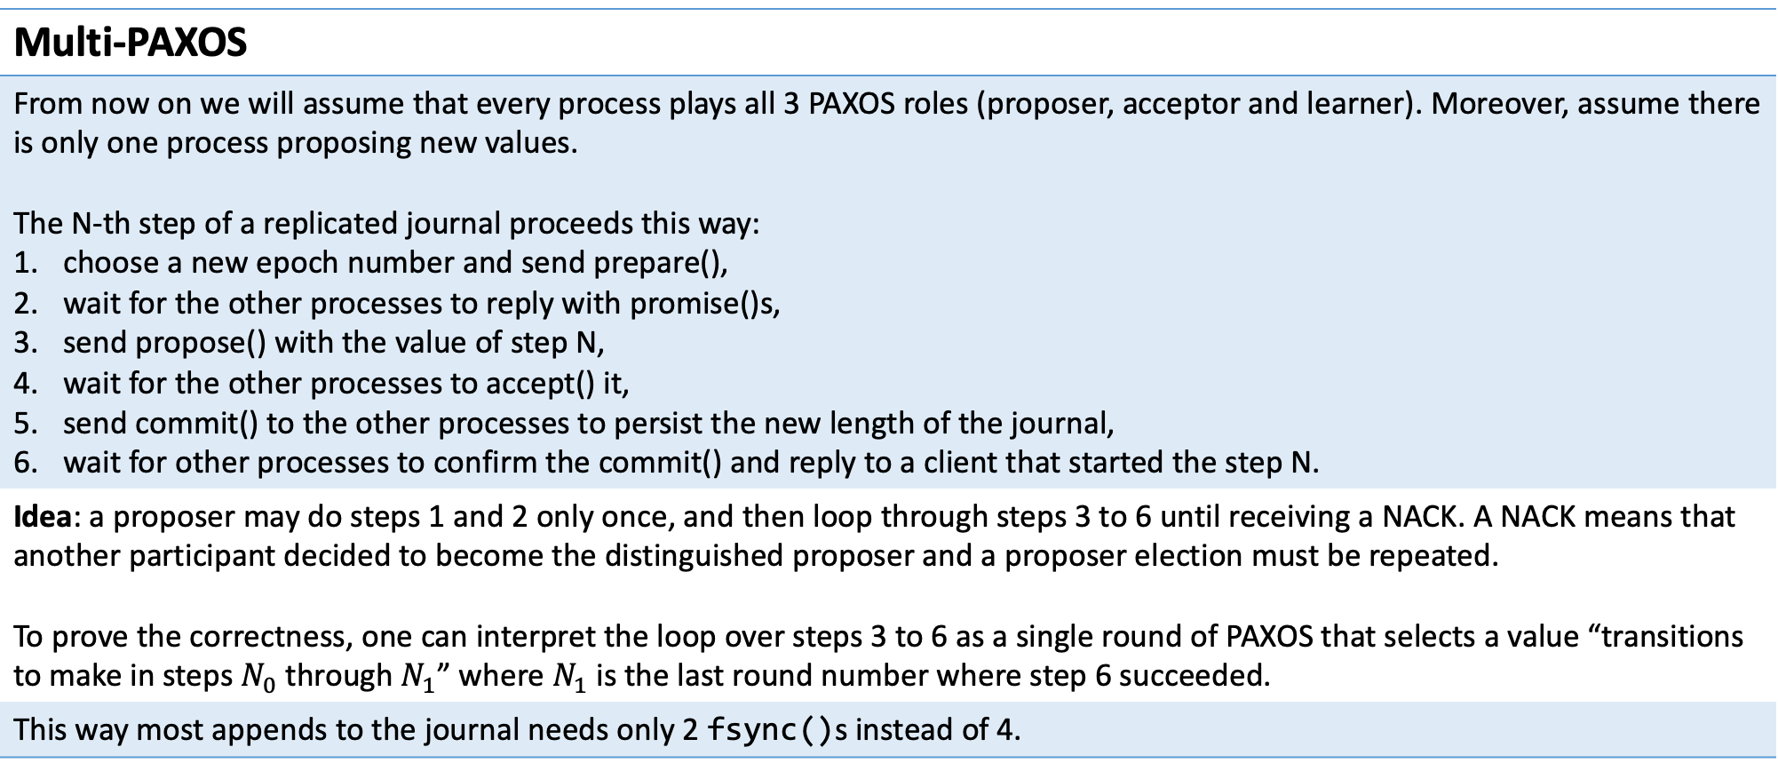
The basics of file systems
Multi-PAXOS
From now on we will assume that every process plays all 3 PAXOS roles (proposer, acceptor and learner). Moreover, assume there is only one process proposing new values. The N-th step of a replicated journal proceeds this way: choose a new epoch number and send prepare(), wait for the other processes to reply with promise()s, send propose() with the value of step N, wait for the other processes to accept() it, send commit() to the other processes to persist the new length of the journal, wait for other processes to confirm the commit() and reply to a client that started the step N.
Idea: a proposer may do steps 1 and 2 only once, and then loop through steps 3 to 6 until receiving a NACK. A NACK means that another participant decided to become the distinguished proposer and a proposer election must be repeated. To prove the correctness, one can interpret the loop over steps 3 to 6 as a single round of PAXOS that selects a value “transitions to make in steps $N_{0}$ through $N_{1}$” where $N_{1}$ is the last round number where step 6 succeeded.
This way most appends to the journal needs only 2 fsync()s instead of 4.

Slide 11
The basics of file systems
Multi-PAXOS
From now on we will assume that every process plays all 3 PAXOS roles (proposer, acceptor and learner). Moreover, assume there is only one process proposing new values. The N-th step of a replicated journal proceeds this way: choose a new epoch number and send prepare(), wait for the other processes to reply with promise()s, send propose() with the value of step N, wait for the other processes to accept() it, send commit() to the other processes to persist the new length of the journal, wait for other processes to confirm the commit() and reply to a client that started the step N.
Idea: the number of fsync()s can be reduced further if every iteration of steps 3 to 6 processes a batch of requests instead of single requests. This is possible if a service has multiple clients, and the request queue is always deep enough.
Question: how to choose the batch sizes? – Adaptive batching.

Slide 12
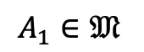
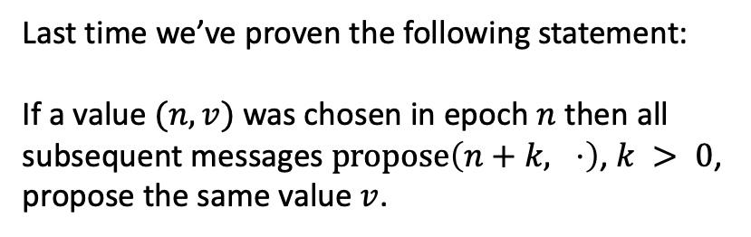
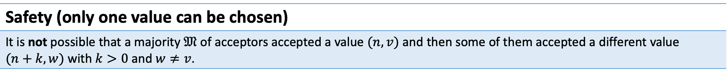
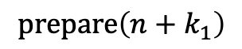
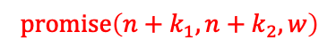
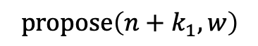
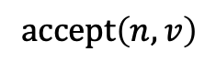
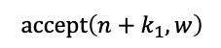
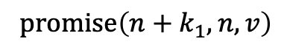
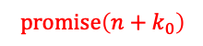
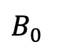
The basics of file systems
Safety (only one value can be chosen)
It is not possible that a majority $𝔐$ of acceptors accepted a value $(n, v)$ and then some of them accepted a different value $(n+k, w)$ with $k>0$ and $w≠v$.
$$B_{0}$$
P’
$$A_{1}∈𝔐$$
Last time we’ve proven the following statement:
If a value $(n,v)$ was chosen in epoch $n$ then all subsequent messages $\operatorname{propose}\left(n+k, ⋅\right)$, $k > 0$, propose the same value $v$.
$$\operatorname{prepare}\left(n+k_{1}\right)$$
$$\operatorname{accept}\left(n, v\right)$$
$$\operatorname{promise}\left(n+k_{1}, n, v\right)$$
$$\operatorname{promise}\left(n+k_{1}, n+k_{2}, w\right)$$
$$\operatorname{propose}\left(n+k_{1}, w\right)$$
$$\operatorname{accept}\left(n+k_{1}, w\right)$$
$$\operatorname{promise}\left(n+k_{0}\right)$$

Slide 13
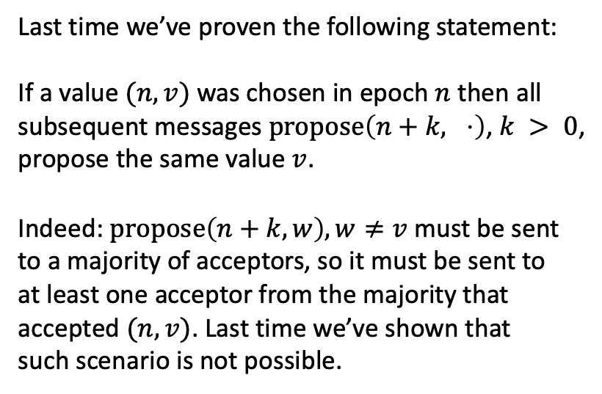
The basics of file systems
Safety (only one value can be chosen)
It is not possible that a majority $𝔐$ of acceptors accepted a value $(n, v)$ and then some of them accepted a different value $(n+k, w)$ with $k>0$ and $w≠v$.
$$B_{0}$$
P’
$$A_{1}∈𝔐$$
Last time we’ve proven the following statement:
If a value $(n,v)$ was chosen in epoch $n$ then all subsequent messages $\operatorname{propose}\left(n+k, ⋅\right)$, $k > 0$, propose the same value $v$.
Indeed: $\operatorname{propose}\left(n+k, w\right), w≠v$ must be sent to a majority of acceptors, so it must be sent to at least one acceptor from the majority that accepted $(n, v)$. Last time we’ve shown that such scenario is not possible.
$$\operatorname{prepare}\left(n+k_{1}\right)$$
$$\operatorname{accept}\left(n, v\right)$$
$$\operatorname{promise}\left(n+k_{1}, n, v\right)$$
$$\operatorname{promise}\left(n+k_{1}, n+k_{2}, w\right)$$
$$\operatorname{propose}\left(n+k_{1}, w\right)$$
$$\operatorname{accept}\left(n+k_{1}, w\right)$$
$$\operatorname{promise}\left(n+k_{0}\right)$$

Slide 14
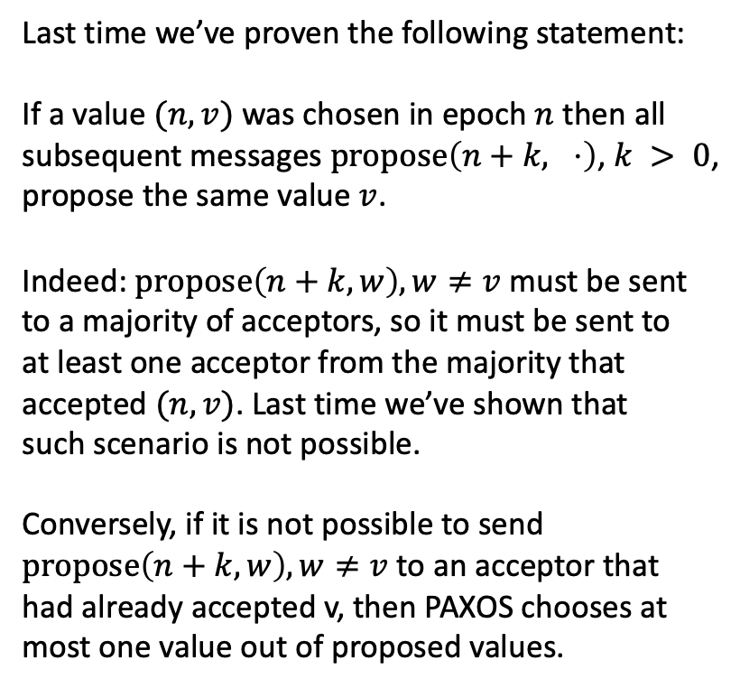
The basics of file systems
Safety (only one value can be chosen)
It is not possible that a majority $𝔐$ of acceptors accepted a value $(n, v)$ and then some of them accepted a different value $(n+k, w)$ with $k>0$ and $w≠v$.
$$B_{0}$$
P’
$$A_{1}∈𝔐$$
Last time we’ve proven the following statement:
If a value $(n,v)$ was chosen in epoch $n$ then all subsequent messages $\operatorname{propose}\left(n+k, ⋅\right)$, $k > 0$, propose the same value $v$.
Indeed: $\operatorname{propose}\left(n+k, w\right), w≠v$ must be sent to a majority of acceptors, so it must be sent to at least one acceptor from the majority that accepted $(n, v)$. Last time we’ve shown that such scenario is not possible.
Conversely, if it is not possible to send $\operatorname{propose}\left(n+k, w\right), w≠v$ to an acceptor that had already accepted v, then PAXOS chooses at most one value out of proposed values.
$$\operatorname{prepare}\left(n+k_{1}\right)$$
$$\operatorname{accept}\left(n, v\right)$$
$$\operatorname{promise}\left(n+k_{1}, n, v\right)$$
$$\operatorname{promise}\left(n+k_{1}, n+k_{2}, w\right)$$
$$\operatorname{propose}\left(n+k_{1}, w\right)$$
$$\operatorname{accept}\left(n+k_{1}, w\right)$$
$$\operatorname{promise}\left(n+k_{0}\right)$$

Slide 15
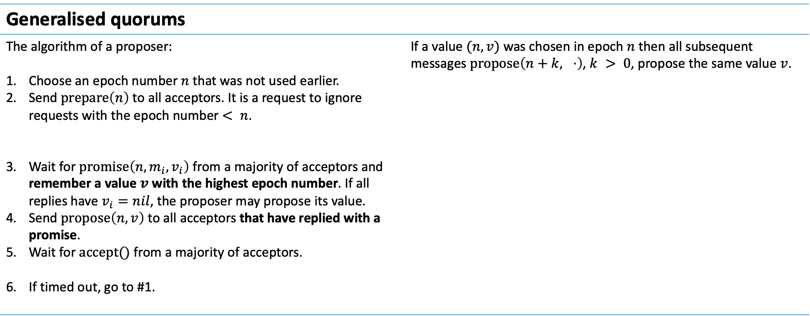
The basics of file systems
Generalised quorums
The algorithm of a proposer: Choose an epoch number $n$ that was not used earlier. Send $\operatorname{prepare}\left(n\right)$ to all acceptors. It is a request to ignore requests with the epoch number $< n$. Wait for $\operatorname{promise}\left(n, m_{i}, v_{i}\right)$ from a majority of acceptors and remember a value $v$ with the highest epoch number. If all replies have $v_{i}=nil$, the proposer may propose its value. Send $\operatorname{propose}\left(n, v\right)$ to all acceptors that have replied with a promise. Wait for $accept()$ from a majority of acceptors. If timed out, go to #1. | If a value $(n,v)$ was chosen in epoch $n$ then all subsequent messages $\operatorname{propose}\left(n+k, ⋅\right)$, $k > 0$, propose the same value $v$.

Slide 16
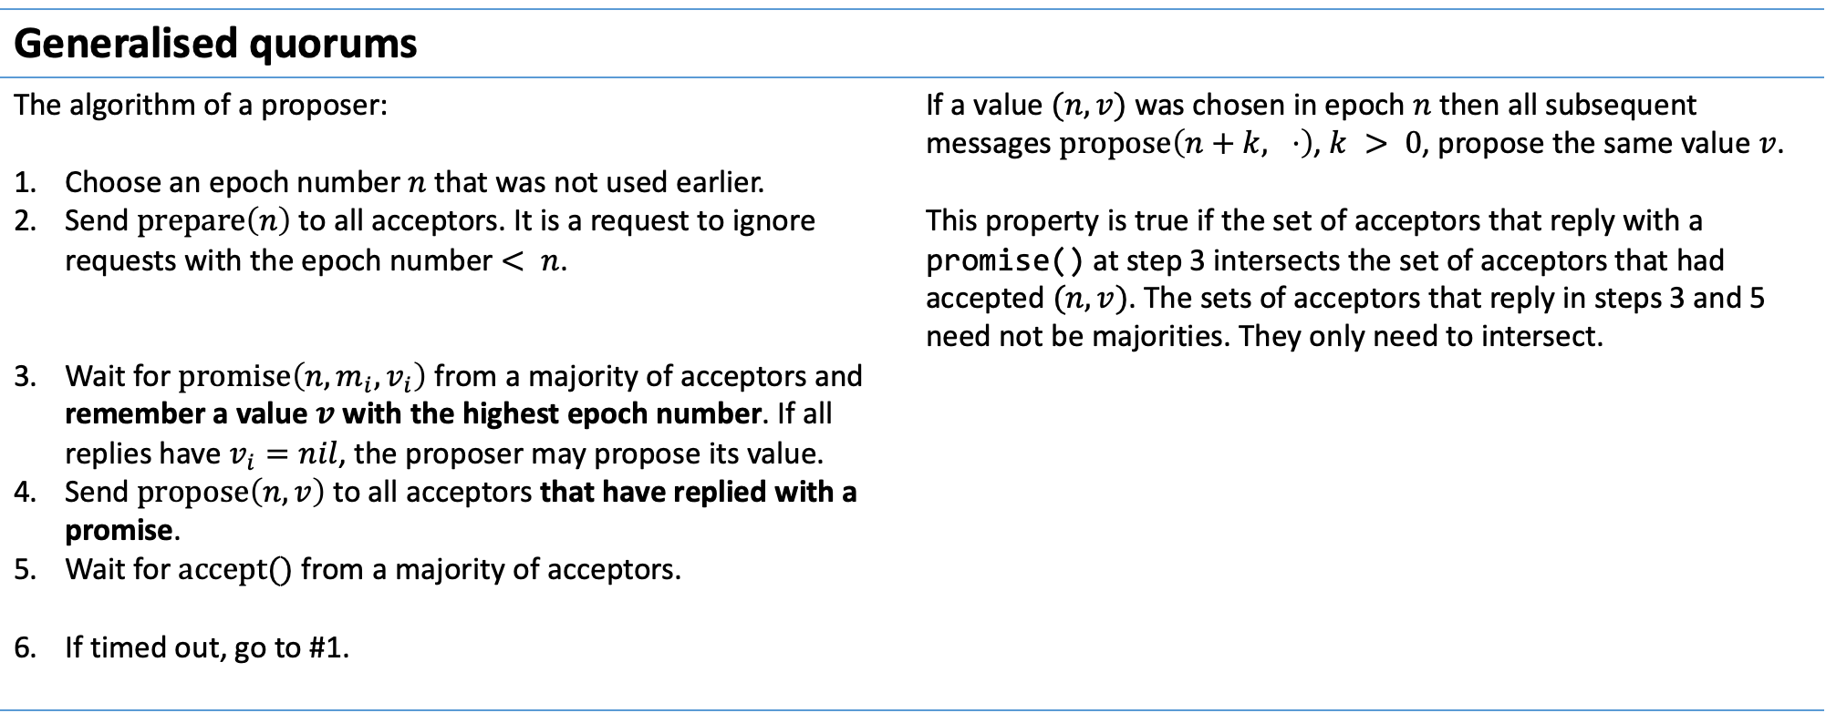
The basics of file systems
Generalised quorums
The algorithm of a proposer: Choose an epoch number $n$ that was not used earlier. Send $\operatorname{prepare}\left(n\right)$ to all acceptors. It is a request to ignore requests with the epoch number $< n$. Wait for $\operatorname{promise}\left(n, m_{i}, v_{i}\right)$ from a majority of acceptors and remember a value $v$ with the highest epoch number. If all replies have $v_{i}=nil$, the proposer may propose its value. Send $\operatorname{propose}\left(n, v\right)$ to all acceptors that have replied with a promise. Wait for $accept()$ from a majority of acceptors. If timed out, go to #1. | If a value $(n,v)$ was chosen in epoch $n$ then all subsequent messages $\operatorname{propose}\left(n+k, ⋅\right)$, $k > 0$, propose the same value $v$. This property is true if the set of acceptors that reply with a promise() at step 3 intersects the set of acceptors that had accepted $(n,v)$. The sets of acceptors that reply in steps 3 and 5 need not be majorities. They only need to intersect.

Slide 17
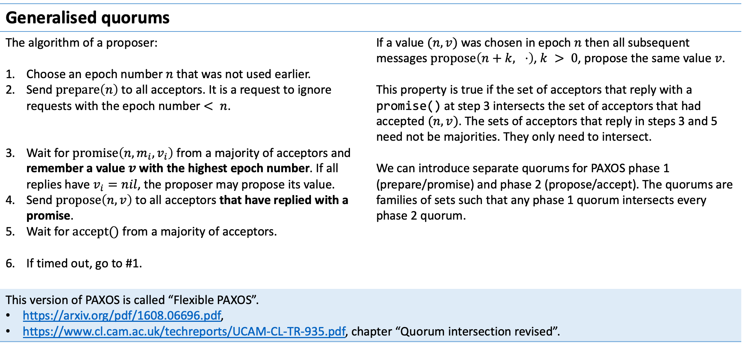
The basics of file systems
Generalised quorums
The algorithm of a proposer: Choose an epoch number $n$ that was not used earlier. Send $\operatorname{prepare}\left(n\right)$ to all acceptors. It is a request to ignore requests with the epoch number $< n$. Wait for $\operatorname{promise}\left(n, m_{i}, v_{i}\right)$ from a majority of acceptors and remember a value $v$ with the highest epoch number. If all replies have $v_{i}=nil$, the proposer may propose its value. Send $\operatorname{propose}\left(n, v\right)$ to all acceptors that have replied with a promise. Wait for $accept()$ from a majority of acceptors. If timed out, go to #1. | If a value $(n,v)$ was chosen in epoch $n$ then all subsequent messages $\operatorname{propose}\left(n+k, ⋅\right)$, $k > 0$, propose the same value $v$. This property is true if the set of acceptors that reply with a promise() at step 3 intersects the set of acceptors that had accepted $(n,v)$. The sets of acceptors that reply in steps 3 and 5 need not be majorities. They only need to intersect. We can introduce separate quorums for PAXOS phase 1 (prepare/promise) and phase 2 (propose/accept). The quorums are families of sets such that any phase 1 quorum intersects every phase 2 quorum.
This version of PAXOS is called “Flexible PAXOS”. https://arxiv.org/pdf/1608.06696.pdf, https://www.cl.cam.ac.uk/techreports/UCAM-CL-TR-935.pdf, chapter “Quorum intersection revised”.

Slide 18
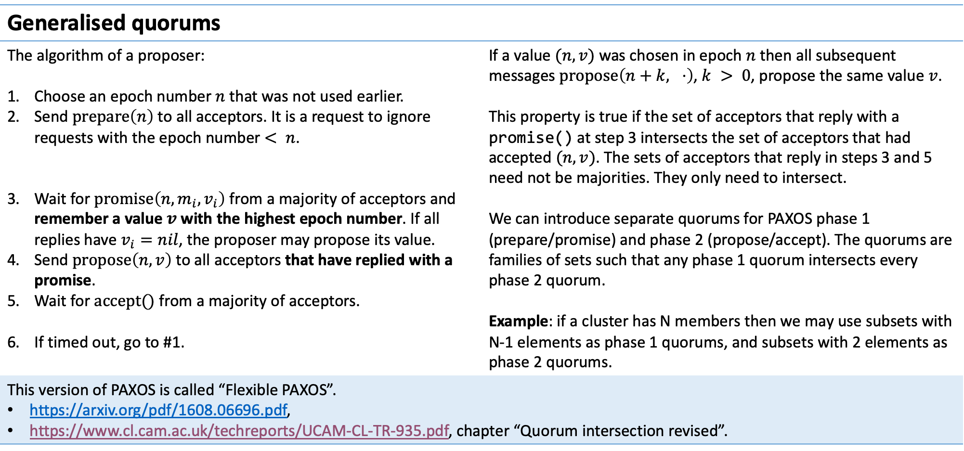
The basics of file systems
Generalised quorums
The algorithm of a proposer: Choose an epoch number $n$ that was not used earlier. Send $\operatorname{prepare}\left(n\right)$ to all acceptors. It is a request to ignore requests with the epoch number $< n$. Wait for $\operatorname{promise}\left(n, m_{i}, v_{i}\right)$ from a majority of acceptors and remember a value $v$ with the highest epoch number. If all replies have $v_{i}=nil$, the proposer may propose its value. Send $\operatorname{propose}\left(n, v\right)$ to all acceptors that have replied with a promise. Wait for $accept()$ from a majority of acceptors. If timed out, go to #1. | If a value $(n,v)$ was chosen in epoch $n$ then all subsequent messages $\operatorname{propose}\left(n+k, ⋅\right)$, $k > 0$, propose the same value $v$. This property is true if the set of acceptors that reply with a promise() at step 3 intersects the set of acceptors that had accepted $(n,v)$. The sets of acceptors that reply in steps 3 and 5 need not be majorities. They only need to intersect. We can introduce separate quorums for PAXOS phase 1 (prepare/promise) and phase 2 (propose/accept). The quorums are families of sets such that any phase 1 quorum intersects every phase 2 quorum. Example: if a cluster has N members then we may use subsets with N-1 elements as phase 1 quorums, and subsets with 2 elements as phase 2 quorums.
This version of PAXOS is called “Flexible PAXOS”. https://arxiv.org/pdf/1608.06696.pdf, https://www.cl.cam.ac.uk/techreports/UCAM-CL-TR-935.pdf, chapter “Quorum intersection revised”.

Slide 19
The basics of file systems
Multi-PAXOS + Flexible PAXOS
From now on we will assume that every process plays all 3 PAXOS roles (proposer, acceptor and learner). Moreover, assume there is only one process proposing new values. The N-th step of a replicated journal proceeds this way: choose a new epoch number and send prepare(), wait for the other processes to reply with promise()s, send propose() with the value of step N, wait for the other processes to accept() it, send commit() to the other processes to persist the new length of the journal, wait for other processes to confirm the commit() and reply to a client that started the step N.
Observation: the latency of phase 2 depends on the size of phase 2 quorums. We can decrease it by decreasing the size of phase 2 quorums which is possible if we make phase 1 quorums larger.

Slide 20
The basics of file systems
Multi-PAXOS + Flexible PAXOS
From now on we will assume that every process plays all 3 PAXOS roles (proposer, acceptor and learner). Moreover, assume there is only one process proposing new values. The N-th step of a replicated journal proceeds this way: choose a new epoch number and send prepare(), wait for the other processes to reply with promise()s, send propose() with the value of step N, wait for the other processes to accept() it, send commit() to the other processes to persist the new length of the journal, wait for other processes to confirm the commit() and reply to a client that started the step N.
Observation: the latency of phase 2 depends on the size of phase 2 quorums. We can decrease it by decreasing the size of phase 2 quorums which is possible if we make phase 1 quorums larger.
Batching + small phase 2 quorums reduce the number of fsync()s needed per each operation and make tail latencies less pronounced. Still, PAXOS is not a tool to increase the throughput of a system by adding more nodes. It is a way to implement fault-tolerance. Typically, PAXOS is used to persist decisions on partitioning a system and choosing masters for subsets of data.

Slide 21
The basics of file systems
Replicated FSM
From now on we will assume that every process plays all 3 PAXOS roles (proposer, acceptor and learner). Moreover, assume there is only one process proposing new values. The N-th step of a replicated journal proceeds this way: choose a new epoch number and send prepare(), wait for the other processes to reply with promise()s, send propose() with the value of step N, wait for the other processes to accept() it, send commit() to the other processes to persist the new length of the journal, wait for other processes to confirm the commit() and reply to a client that started the step N.
Questions: Suppose a process lags behind the cluster (suppose it had network problems for a while). How does it catch up? Every prepare() and promise() from a process P includes the number of the last step committed by P. This way processes can learn that a cluster member is lagging and can send it the missing tail. How many fsync()s does each step need?

Slide 22
The basics of file systems
Replicated FSM
Problem: the journal of an FSM grows indefinitely, but cluster members do not have unlimited disk space.

Slide 23
The basics of file systems
Replicated FSM
Problem: the journal of an FSM grows indefinitely, but cluster members do not have unlimited disk space.
Solution: make regular snapshots of the FSM and store only the journal tail that has changes since the last snapshot.

Slide 24
The basics of file systems
Replicated FSM
Problem: the journal of an FSM grows indefinitely, but cluster members do not have unlimited disk space.
Solution: make regular snapshots of the FSM and store only the journal tail that has changes since the last snapshot.
More problems: Making a snapshot may not block modifications of the FSM so as to introduce no latency. Cluster nodes that lag behind* can no longer catch up by copying a part of the journal. They may need to copy a whole snapshot. What happens if copying a snapshot S takes too long to transfer and S is replaced with S’ during the copy?
* A cluster need not be unhealthy for some nodes to lag behind. Consider adding a new node to a cluster.

Slide 25
The basics of file systems
Reminder: the failure model of PAXOS
Participant processes may work at arbitrary speed. Processes may crash and restart at any moment. Messages may be delayed (in particular, reordered), lost, or duplicated, but they cannot be corrupted.

Slide 26
The basics of file systems
Network-ordered PAXOS
Participant processes may work at arbitrary speed. Processes may crash and restart at any moment. Messages may be delayed (in particular, reordered), lost, or duplicated, but they cannot be corrupted.
These assumptions are true in commodity networks, but custom hardware gives us more options.

Slide 27
The basics of file systems
Network-ordered PAXOS
Participant processes may work at arbitrary speed. Processes may crash and restart at any moment. Messages may be delayed (in particular, reordered), lost, or duplicated, but they cannot be corrupted.
These assumptions are true in commodity networks, but custom hardware gives us more options. Programmable switches can modify IP packets on the fly and can order packets that arrive via different ports: Intel Tofino: https://hc32.hotchips.org/assets/program/conference/day2/HotChips2020_Networking_Tofino.pdf Microsoft Sirius (in use by Azure): https://www.usenix.org/system/files/nsdi23-bansal.pdf

Slide 28
The basics of file systems
Network-ordered PAXOS
Participant processes may work at arbitrary speed. Processes may crash and restart at any moment. Messages may be delayed (in particular, reordered), lost, or duplicated, but they cannot be corrupted.
These assumptions are true in commodity networks, but custom hardware gives us more options. Programmable switches can modify IP packets on the fly and can order packets that arrive via different ports: Intel Tofino: https://hc32.hotchips.org/assets/program/conference/day2/HotChips2020_Networking_Tofino.pdf Microsoft Sirius (in use by Azure): https://www.usenix.org/system/files/nsdi23-bansal.pdf A programmable switch can augment every IP packet with an additional header that contains a global sequence counter.

Slide 29
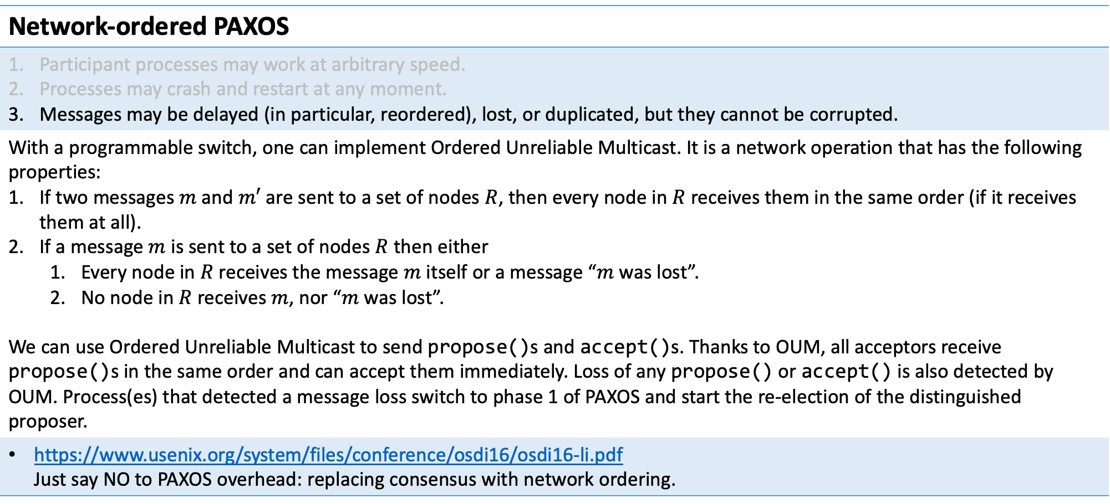
The basics of file systems
Network-ordered PAXOS
Participant processes may work at arbitrary speed. Processes may crash and restart at any moment. Messages may be delayed (in particular, reordered), lost, or duplicated, but they cannot be corrupted.
With a programmable switch, one can implement Ordered Unreliable Multicast. It is a network operation that has the following properties: If two messages $m$ and $m′$ are sent to a set of nodes $R$, then every node in $R$ receives them in the same order (if it receives them at all). If a message $m$ is sent to a set of nodes $R$ then either Every node in $R$ receives the message $m$ itself or a message “$m$ was lost”. No node in $R$ receives $m$, nor “$m$ was lost”. We can use Ordered Unreliable Multicast to send propose()s and accept()s. Thanks to OUM, all acceptors receive propose()s in the same order and can accept them immediately. Loss of any propose() or accept() is also detected by OUM. Process(es) that detected a message loss switch to phase 1 of PAXOS and start the re-election of the distinguished proposer.
https://www.usenix.org/system/files/conference/osdi16/osdi16-li.pdf Just say NO to PAXOS overhead: replacing consensus with network ordering.

Slide 30
The basics of file systems
Failures of cluster nodes
Participant processes may work at arbitrary speed. Processes may crash and restart at any moment. Messages may be delayed (in particular, reordered), lost, or duplicated, but they cannot be corrupted.

Slide 31
The basics of file systems
Failures of cluster nodes
Participant processes may work at arbitrary speed. Processes may crash and restart at any moment. Messages may be delayed (in particular, reordered), lost, or duplicated, but they cannot be corrupted.
PAXOS assumes that cluster nodes follow the rules of PAXOS even in the face of bit rot that may randomly corrupt the on-disk or in-memory state of nodes, bugs in the implementation of nodes.
It is not feasible or reasonable to prove the correctness of cluster nodes in most cases, but we can make failures rare enough: Consistency checks at all steps, Randomised tests and fault injection.

Slide 32
The basics of file systems
Failures of cluster nodes
Participant processes may work at arbitrary speed. Processes may crash and restart at any moment. Messages may be delayed (in particular, reordered), lost, or duplicated, but they cannot be corrupted.
PAXOS assumes that cluster nodes follow the rules of PAXOS even in the face of bit rot that may randomly corrupt the on-disk or in-memory state of nodes, bugs in the implementation of nodes.
It is not feasible or reasonable to prove the correctness of cluster nodes in most cases, but we can make failures rare enough: Consistency checks at all steps, Randomised tests and fault injection.
Chaos engineering: https://github.com/netflix/chaosmonkey

Slide 33
The basics of file systems
Failures of cluster nodes
Participant processes may work at arbitrary speed. Processes may crash and restart at any moment. Messages may be delayed (in particular, reordered), lost, or duplicated, but they cannot be corrupted.
PAXOS assumes that cluster nodes follow the rules of PAXOS even in the face of bit rot that may randomly corrupt the on-disk or in-memory state of nodes, bugs in the implementation of nodes.
It is not feasible or reasonable to prove the correctness of cluster nodes in most cases, but we can make failures rare enough: Consistency checks at all steps, Randomised tests and fault injection.
Chaos engineering: https://github.com/netflix/chaosmonkey Distributed systems safety research: https://jepsen.io

Slide 34
The basics of file systems
Failures of cluster nodes
Participant processes may work at arbitrary speed. Processes may crash and restart at any moment. Messages may be delayed (in particular, reordered), lost, or duplicated, but they cannot be corrupted.
PAXOS assumes that cluster nodes follow the rules of PAXOS even in the face of bit rot that may randomly corrupt the on-disk or in-memory state of nodes, bugs in the implementation of nodes.
It is not feasible or reasonable to prove the correctness of cluster nodes in most cases, but we can make failures rare enough: Consistency checks at all steps, Randomised tests and fault injection.
Chaos engineering: https://github.com/netflix/chaosmonkey Distributed systems safety research: https://jepsen.io Deterministic simulation: https://github.com/asatarin/testing-distributed-systems?tab=readme-ov-file#foundationdb https://antithesis.com/blog/deterministic_hypervisor

Slide 35
The basics of file systems
Failures of cluster nodes
Participant processes may work at arbitrary speed. Processes may crash and restart at any moment. Messages may be delayed (in particular, reordered), lost, or duplicated, but they cannot be corrupted.
PAXOS assumes that cluster nodes follow the rules of PAXOS even in the face of bit rot that may randomly corrupt the on-disk or in-memory state of nodes, bugs in the implementation of nodes.
It is not feasible or reasonable to prove the correctness of cluster nodes in most cases, but we can make failures rare enough: Consistency checks at all steps, Randomised tests and fault injection.
Chaos engineering: https://github.com/netflix/chaosmonkey Distributed systems safety research: https://jepsen.io Deterministic simulation: https://github.com/asatarin/testing-distributed-systems?tab=readme-ov-file#foundationdb https://antithesis.com/blog/deterministic_hypervisor Fuzz testing, generation of random test inputs and minimisation of testcases: https://go.dev/doc/security/fuzz/ https://www.cse.chalmers.se/edu/year/2012/course/DIT848/files/13-GL-QuickCheck.pdf https://github.com/google/AFL

Slide 36
The basics of file systems
Failures of cluster nodes
Participant processes may work at arbitrary speed. Processes may crash and restart at any moment. Messages may be delayed (in particular, reordered), lost, or duplicated, but they cannot be corrupted.
PAXOS assumes that cluster nodes follow the rules of PAXOS even in the face of bit rot that may randomly corrupt the on-disk or in-memory state of nodes, bugs in the implementation of nodes.
It is not feasible or reasonable to prove the correctness of cluster nodes in most cases, but we can make failures rare enough: Consistency checks at all steps, Randomised tests and fault injection.
Chaos engineering: https://github.com/netflix/chaosmonkey Distributed systems safety research: https://jepsen.io Deterministic simulation: https://github.com/asatarin/testing-distributed-systems?tab=readme-ov-file#foundationdb https://antithesis.com/blog/deterministic_hypervisor Fuzz testing, generation of random test inputs and minimisation of testcases: https://go.dev/doc/security/fuzz/ https://www.cse.chalmers.se/edu/year/2012/course/DIT848/files/13-GL-QuickCheck.pdf https://github.com/google/AFL Simple Testing Can Prevent Most Critical Failures: An Analysis of Production Failures in Distributed Data-Intensive Systems: https://www.usenix.org/system/files/conference/osdi14/osdi14-paper-yuan.pdf

Slide 37
The basics of file systems
Another example of a complex state space
pthread_mutex_t mtx; pthread_cond_t cv; ... std::deque<int> queue; constexpr sizeLimit = ...; ... void put(int x) { pthread_mutex_lock(&mtx); while (queue.size() >= sizeLimit) pthread_cond_wait(&cv, &mtx); queue.push_back(x); pthread_cond_signal(&cv); pthread_mutex_unlock(&mtx); } | int get() { int x; pthread_mutex_lock(&mtx); while (queue.empty()) pthread_cond_wait(&cv, &mtx); x = queue.pop_front(); pthread_cond_signal(&cv); pthread_mutex_unlock(&mtx); return x; } | The problem: implement a bounded queue that supports multiple concurrent readers and writers. The implementation on this slide has a problem that happens only when the total number of users is greater than the maximum queue depth, happens rarely even if condition #1 is satisfied.

Slide 38
The basics of file systems
Another example of a complex state space
pthread_mutex_t mtx; pthread_cond_t cv; ... std::deque<int> queue; constexpr sizeLimit = ...; ... void put(int x) { pthread_mutex_lock(&mtx); while (queue.size() >= sizeLimit) pthread_cond_wait(&cv, &mtx); queue.push_back(x); pthread_cond_signal(&cv); pthread_mutex_unlock(&mtx); } | int get() { int x; pthread_mutex_lock(&mtx); while (queue.empty()) pthread_cond_wait(&cv, &mtx); x = queue.pop_front(); pthread_cond_signal(&cv); pthread_mutex_unlock(&mtx); return x; } | The problem: implement a bounded queue that supports multiple concurrent readers and writers. The implementation on this slide has a problem that happens only when the total number of users is greater than the maximum queue depth, happens rarely even if condition #1 is satisfied.

Slide 39
The basics of file systems
Another example of a complex state space
pthread_mutex_t mtx; pthread_cond_t cv; ... std::deque<int> queue; constexpr sizeLimit = ...; ... void put(int x) { pthread_mutex_lock(&mtx); while (queue.size() >= sizeLimit) pthread_cond_wait(&cv, &mtx); queue.push_back(x); pthread_cond_signal(&cv); pthread_mutex_unlock(&mtx); } | int get() { int x; pthread_mutex_lock(&mtx); while (queue.empty()) pthread_cond_wait(&cv, &mtx); x = queue.pop_front(); pthread_cond_signal(&cv); pthread_mutex_unlock(&mtx); return x; } | The problem: implement a bounded queue that supports multiple concurrent readers and writers. The implementation on this slide has a problem that happens only when the total number of users is greater than the maximum queue depth, happens rarely even if condition #1 is satisfied. Readers are supposed to wake writers, and vice versa. However, pthread_cond_signal() wakes a random sleeping thread.

Slide 40
The basics of file systems
A model of a bounded queue
Let us model the program from the previous slide with TLA+. See: Specifying systems, https://lamport.azurewebsites.net/tla/book-02-08-08.pdf. We will use TLA+ Model Checker that walks the state space of a model and verifies whether or not a predicate holds in all states. It can do both breadth-first search and randomised depth-first search. Breadth-first search is exhaustive and yields shortest paths to states that invalidate a predicate. Depth-first search can explore parts of state spaces that are too big.

Slide 41
The basics of file systems
A model of a bounded queue
Let us model the program from the previous slide with TLA+. See: Specifying systems, https://lamport.azurewebsites.net/tla/book-02-08-08.pdf.
We will proceed this way: Declare tunable parameters of the model. Typically, these are parameters like the number of participant processes, the maximum capacity of queues, etc. Declare variables that describe the state. Unlike tunables from #1, variables change upon every state transition. Declare predicates that hold at every state of the model. Declare a predicate that defines the initial state. Declare predicates that hold iff the model makes a specific state transition. Examples: “A sends a message to B”, ”B receives a message from A”, “a message is lost”, etc. Construct a formula to express “the system starts at the initial state and makes a state transition at every step”. Declare predicates that we expect to follow from the rules 3-5. Have TLC search the state space for counterexamples to #7.

Slide 42
The basics of file systems
A model of a bounded queue
TLA+ code | LaTeX-formatted
CONSTANT BufferCapacity CONSTANTS Readers, Writers
First, let us list constants that define the properties of our system: the maximum queue depth, the sets of readers and writers.

Slide 43
The basics of file systems
A model of a bounded queue
TLA+ code | LaTeX-formatted
ASSUME Readers /= {} ASSUME Writers /= {} ASSUME (BufferCapacity \in Nat) /\ (BufferCapacity > 0)
{} is the empty set, /= means “not equal”, /\ and \/ are logical “and” and “or”, respectively.

Slide 44
The basics of file systems
A model of a bounded queue
TLA+ code | LaTeX-formatted
VARIABLES bufferLen, threadStates
This declares variables that define the state of the system. The state space explored by TLC is the set of all possible values of these variables. These declarations place no constraints on values of the variables. They may be arbitrary sets.

Slide 45
The basics of file systems
A model of a bounded queue
TLA+ code | LaTeX-formatted
Threads == Readers \cup Writers (* "R" is for Running, "M" is "owns Mutex and running", "S" is for Sleeping *) ThreadState == {"R", "M", "S"} threadStates_TypeInvariant == threadStates \in [Threads -> ThreadState]
threadStates_TypeInvariant is a predicate which is true iff treadStates is a map from the set of threads to the set of thread states. At a later stage we will require threadStates_TypeInvariant to be true in every state of our model. == means “by definition”, {A, B, …} defines a set by listing its elements, [X -> Y] is the set of maps from X to Y.

Slide 46
The basics of file systems
A model of a bounded queue
TLA+ code | LaTeX-formatted
Init == /\ bufferLen = 0 /\ threadStates_TypeInvariant /\ \A t \in Threads: threadStates[t] = "R"
This is a predicate that is true iff the model is in its initial state: the buffer is empty and all threads are runnable.

Slide 47
The basics of file systems
A model of a bounded queue
TLA+ code | LaTeX-formatted
(* t acquires the mutex *) AcquireLock(t) == /\ threadStates[t] = "R" /\ \forall ta \in Threads: threadStates[ta] /= "M" /\ threadStates' = [threadStates EXCEPT ![t] = "M"] /\ UNCHANGED bufferLen
Predicates that describe state transitions do so by placing constraints on the current state and the next possible state. The predicate AcquireLock(t) is true iff thread t acquires the mutex at the current state transition. F[t] is the value of map F at t, x and x’ denote the values of x in the current state and in the next state, respectively, UNCHANGED <<x, y, …>> is a shorthand for x’ = x /\ y’ = y /\ …

Slide 48
The basics of file systems
A model of a bounded queue
TLA+ code | LaTeX-formatted
ReadBlock(t) == /\ t \in Readers /\ threadStates[t] = "M" /\ bufferLen = 0 /\ threadStates' = [threadStates EXCEPT ![t] = "S"] /\ UNCHANGED bufferLen
ReadBlock(t) is true iff thread t attempted to read from the queue, detected that the queue was empty, and blocked. After this transition t sleeps in pthread_condvar_wait(). Note that this transition is only possible if the current thread owns the mutex: threadStates[t] = “M”.

Slide 49
The basics of file systems
A model of a bounded queue
TLA+ code | LaTeX-formatted
ReadOk(t) == /\ t \in Readers /\ threadStates[t] = "M" /\ bufferLen > 0 /\ bufferLen' = bufferLen - 1 /\ UnlockAndWakeOne(t)
ReadOk(t) is true iff thread t read a value from the queue, unlocked the mutex and (possibly) woke another sleeping thread. We will declare UnlockAndWakeOne(t) later.

Slide 50
The basics of file systems
A model of a bounded queue
TLA+ code | LaTeX-formatted
UnlockAndWakeOne(self) == LET sleepingThreads == {t \in Threads: threadStates[t] = "S"} IN IF sleepingThreads = {} THEN threadStates' = [threadStates EXCEPT ![self] = "R"] ELSE \E t \in sleepingThreads: threadStates' = [threadStates EXCEPT ![self] = "R", ![t] = "R"]

Slide 51
The basics of file systems
A model of a bounded queue
TLA+ code | LaTeX-formatted
Next == \E t \in Threads: \/ AcquireLock(t) \/ WriteOk(t) \/ WriteBlock(t) \/ ReadOk(t) \/ ReadBlock(t)
This predicate is true iff the system made a state transition. A state transition may be one of the following actions: a thread acquires a mutex, a thread attempted to write a value and succeeded, or blocked, a thread attempted to read a value and succeeded, or blocked.

Slide 52
The basics of file systems
A model of a bounded queue
TLA+ code | LaTeX-formatted
Spec == Init /\ [][Next]_<<bufferLen, threadStates>>
This is the definition of our model: Init is true in the initial state and Next is true at every state transition. []E is true iff E is true at every state transition.

Slide 53
The basics of file systems
A model of a bounded queue
TLA+ code | LaTeX-formatted
AtMostOneMutexOwner == LET owners == {t \in Threads: threadStates[t] = "M"} IN Cardinality(owners) <= 1 Liveness == LET runnable == {t \in Threads: threadStates[t] \in {"R", "M"}} IN runnable /= {}
Now let us define predicates that describe desired properties of our model: at most one thread owns the mutex, there is at least one runnable thread.

Slide 54
The basics of file systems
A model of a bounded queue
Now let us have TLA+ Model Checker walk the states of our model:

Slide 55
The basics of file systems
A model of a bounded queue
Now let us have TLA+ Model Checker walk the states of our model:

Slide 56
The basics of file systems
To do at home
Use TLC to find a way to transport a goat, a wolf, and a cabbage from one shore of a river to the other one. Idea: Declare predicates that describe the rules of transporting, Declare a predicate “the goat, the wolf and the cabbage are not on the other shore”. Use TLC to find a counterexample to #2.

Slide 57
The basics of file systems
To read
Specifying systems, https://lamport.azurewebsites.net/tla/book-02-08-08.pdf. TLA+ Toolbox https://lamport.azurewebsites.net/tla/toolbox.html.

